Slide 1
Presentation on Visible Light Communication BY Anand Kumar Srivastava(13CSE046) Jay Shankar Gupta(13CSE050) Shivam Kumar Gupta(13CSE045)

Slide 2
CONTENTS
What is VLC
Visible light & Spectrum
Indoor VLC scenario
History
VLC process
-Transmitter
-Receiver
VLCC
Comparison with RF
Applications

Slide 3
What is VLC..???
The visible light communication (VLC) refers to the communication technology which utilizes the visible light source as a signal transmitter, the air as a transmission medium, and the appropriate photodiode as a signal receiving component.

Slide 4
Visible Light :-
Visible light is thus by definition comprised
of visually-perceivable electromagnetic waves.
The visible spectrum covers wave lengths
from 380 nm to 750 nm.

Slide 5
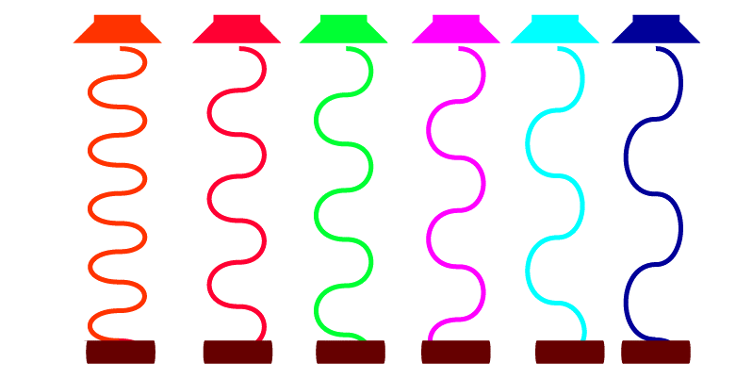
Different wavelengths for different LEDS:

Slide 6
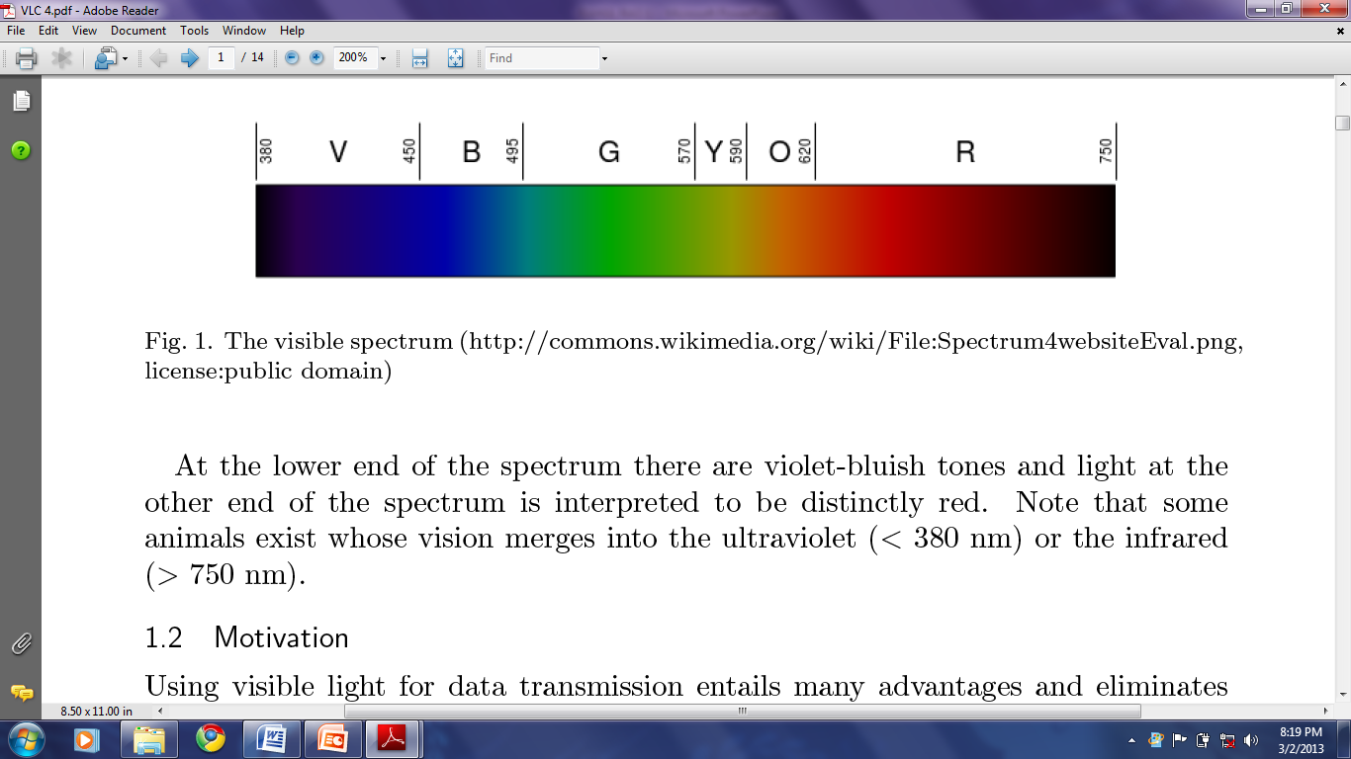
Visible Light Spectrum

Slide 7
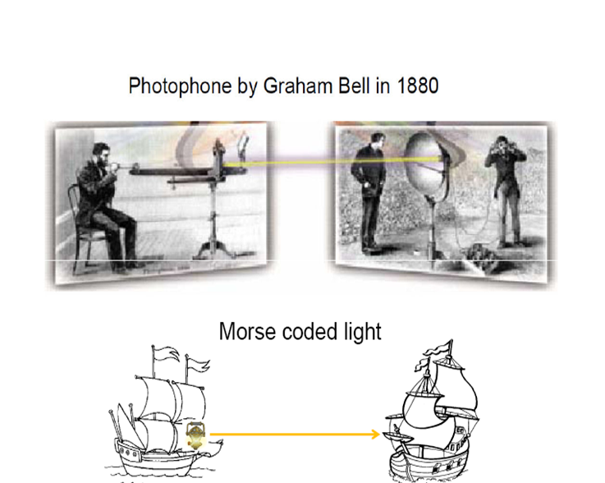
History of VLC

Slide 8
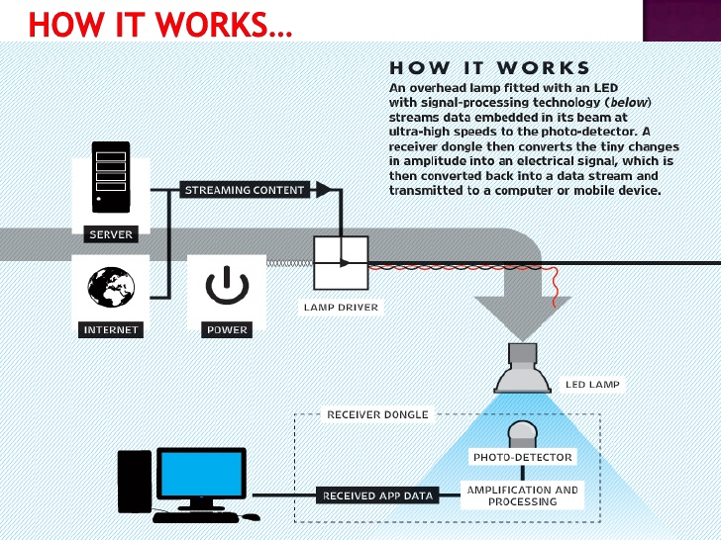

Slide 9
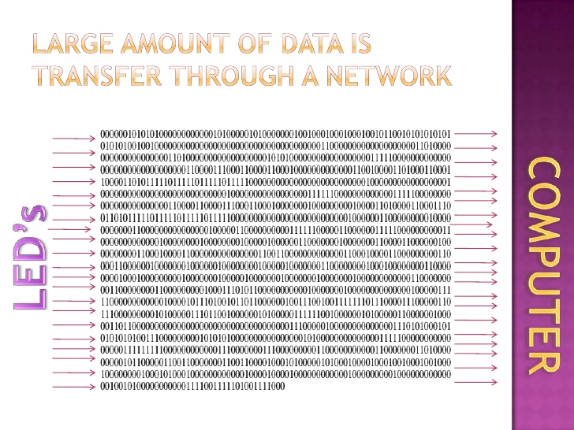

Slide 10
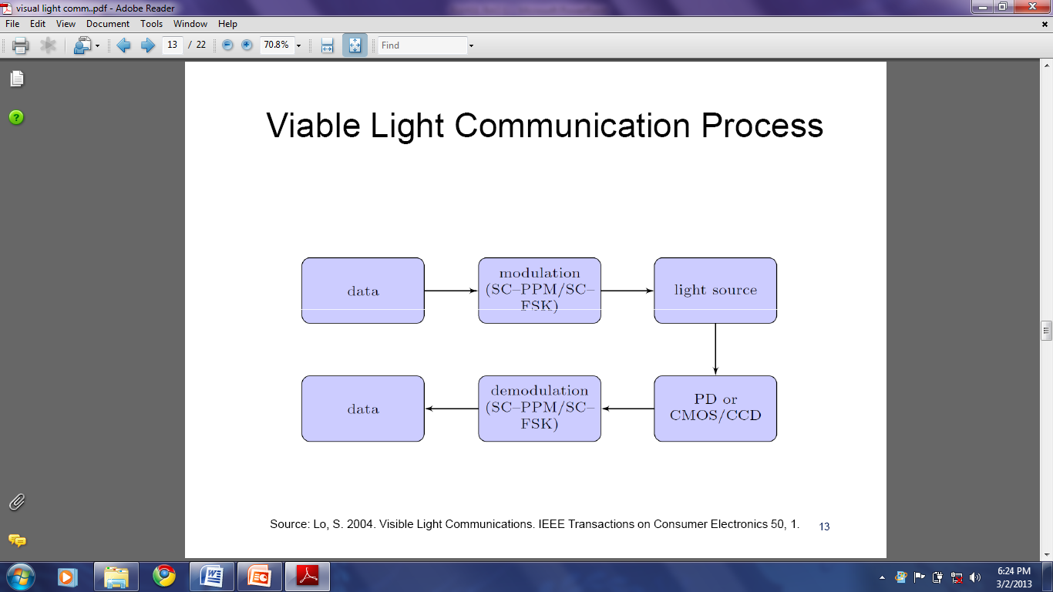
VISIBLE LIGHT COMMUNICATION PROCESS

Slide 11
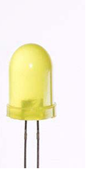
Transmitters:-
LED
Fluorescent Light

Slide 12
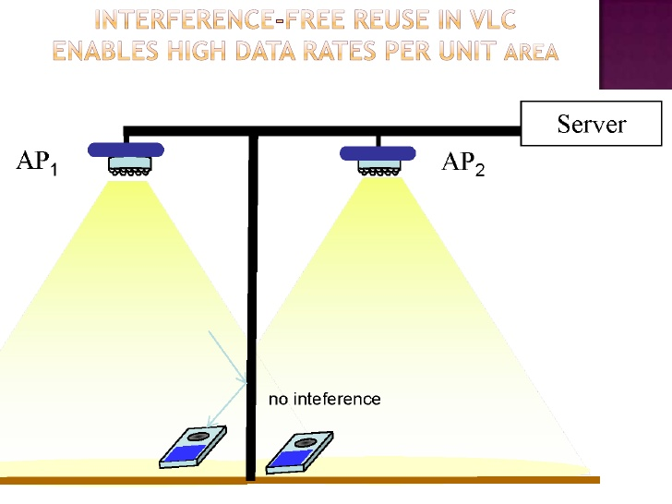

Slide 13
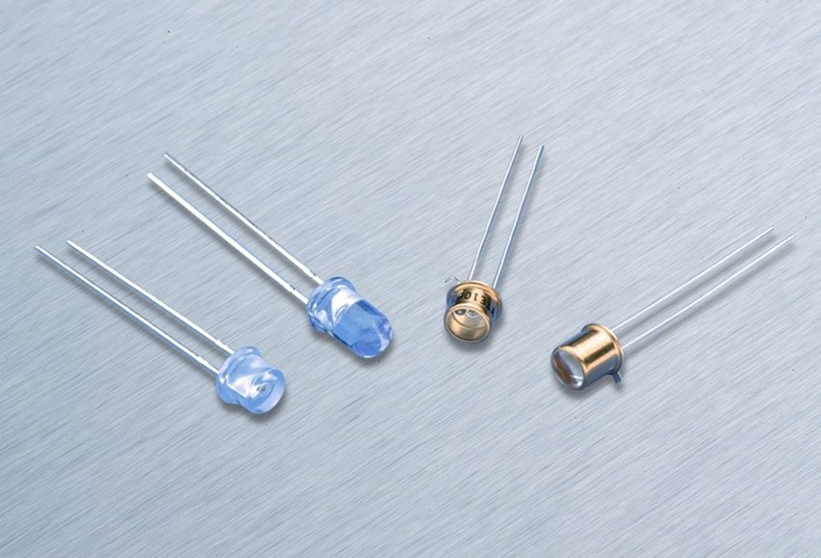
Receiver:-
Photodiode

Slide 14
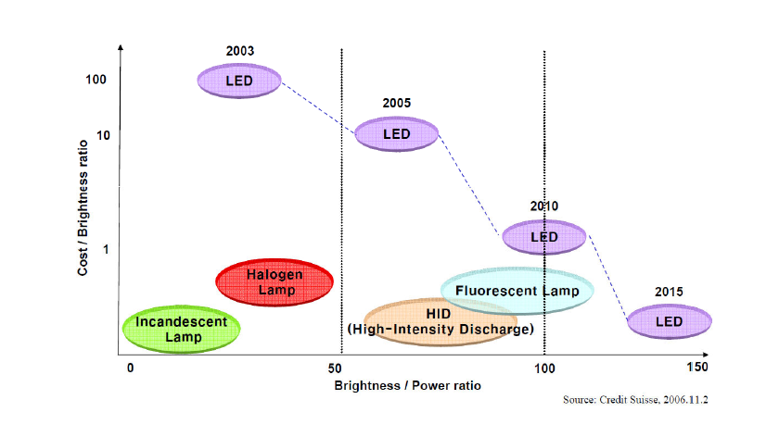
LED Technical Evolution

Slide 15
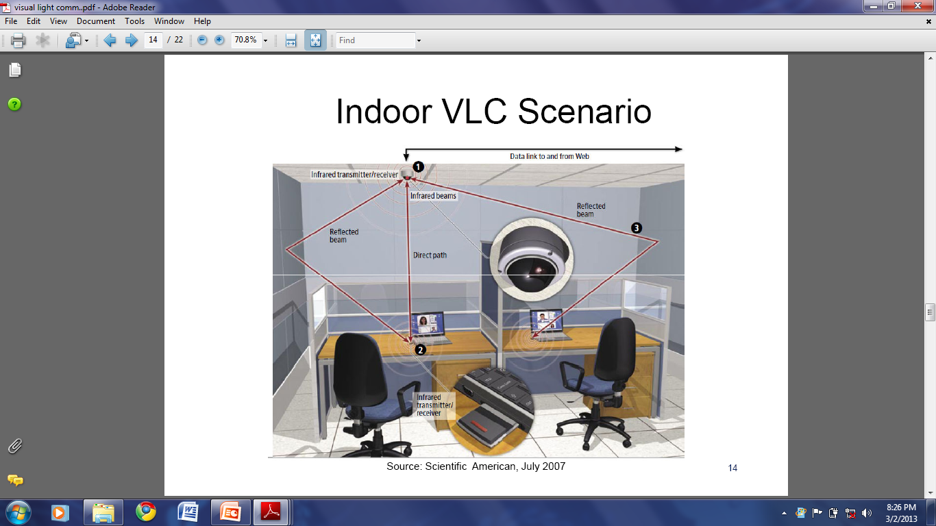
Indoor VLC Scenario

Slide 16
VISIBLE LIGHT COMMUNICATIONS CONSORTIUM(VLCC)
The Visible Light Communications Consortium (VLCC) which is mainly comprised of Japanese technology companies was founded in November 2003. It increases the data speed compared to any communication

Slide 17
VLC CHARACTERISTICS
Human Safety
High Data Rate
Bandwidth
Security
Visibility
Unlicensed Spectrum

Slide 18
VLC vs RF Communication
Limited Transmission Power
Regulated Spectrum:
Banned in Sensitive Areas

Slide 19
Applications of VLC
Position Detection
Intelligent Transport System
Image Sensor Communications
Networking
Audio Applications

Slide 20
CONCLUSION
•LED can be used not only for lighting the
homes but also as means for wireless in-house communication.
After few years the VLC is become more popular

Slide 21
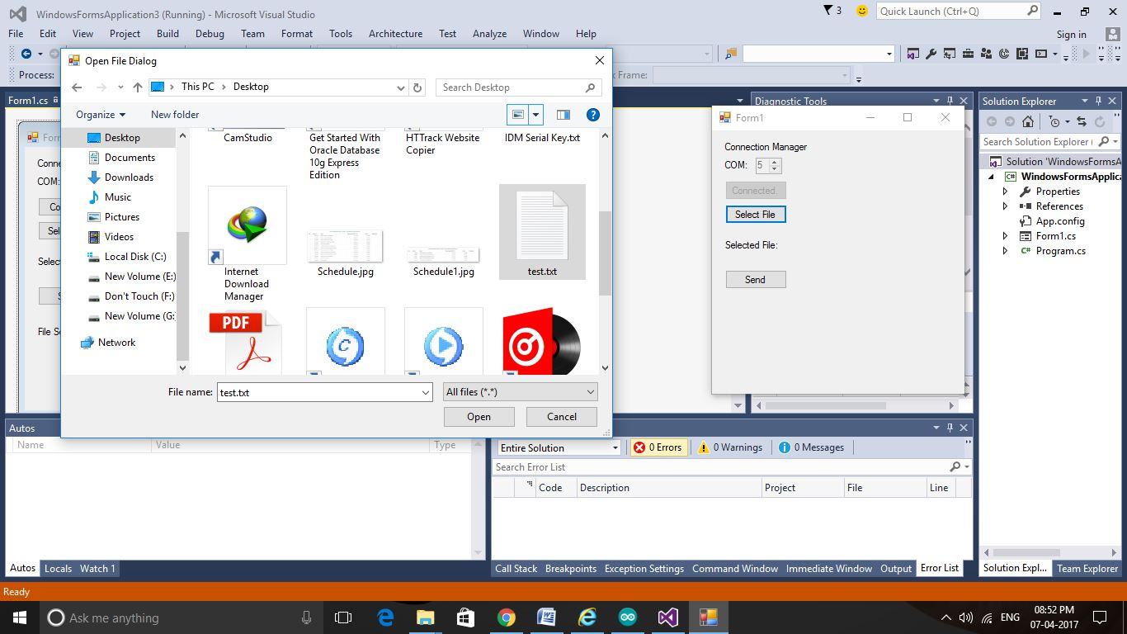
Sender Side Screen Shot 1

Slide 22
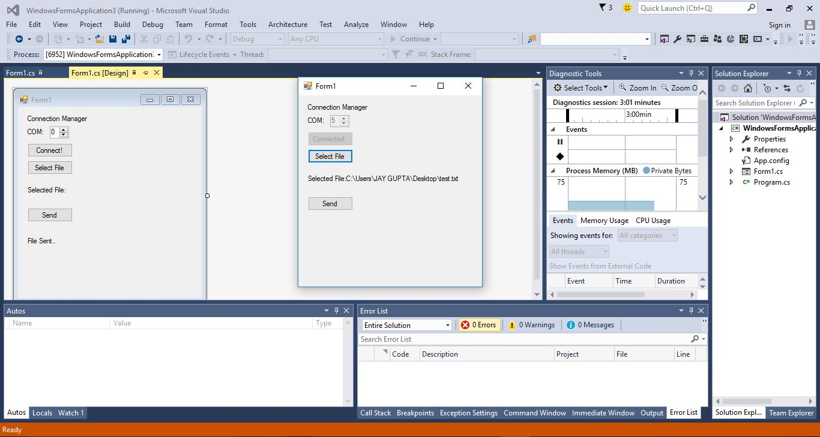
Sender Side Screen Shot 2

Slide 23
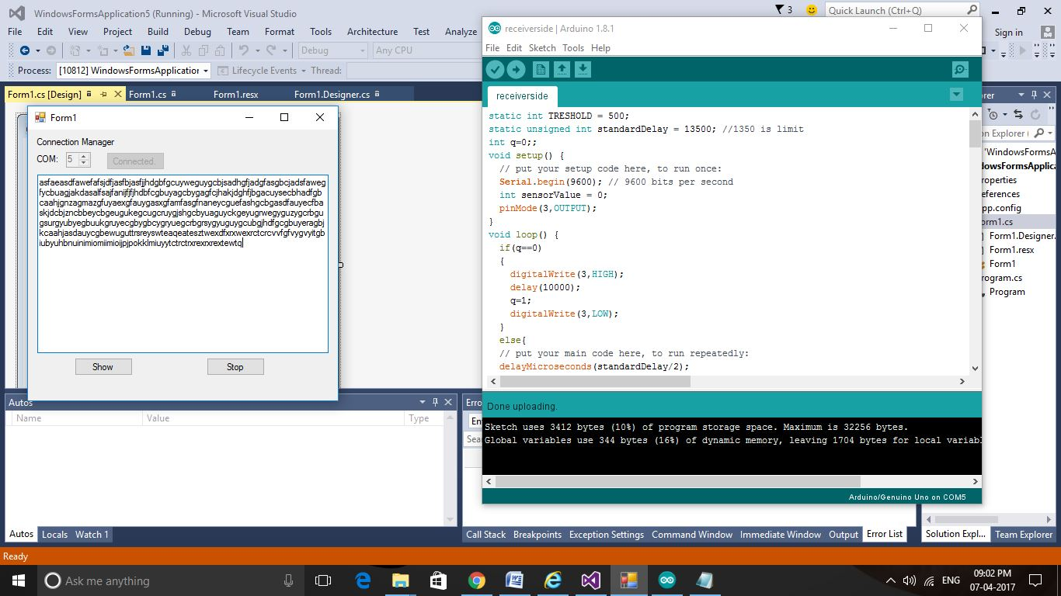
Receiver Side Screen Shot

Slide 24

WORKING MODEL

Slide 25
Thank You

